Slide 1
Paper-1 : IMPLEMENTING AN ISA/IEC-62443 AND ISO/IEC-27001 OT CYBER SECURITY MANAGEMENT SYSTEM AT DUTCH DSO ENEXIS
Enexis is a leading DSO when it comes to applying ICS/ Scada and station distribution automation for its grid management related tasks. Enexis is using these technologies for monitoring and remote switching of HV/MV and strategic distribution stations
This paper presents a real-life implementation of a Cyber Security Management System (CSMS) at Dutch DSO Enexis. The CSMS is based on the international standards ISA/IEC-62443 and ISO/IEC-27001. The combination of these international cyber security standards offers a structured approach for managing cyber security related risks in industrial environments of critical infrastructures like DSOs.
The existing risk management approaches at DSO Enexis did not cover risk management for cyber security related risks sufficiently. Therefore, an ISA/IEC-62443 and ISO/IEC-27001 based OT CSMS was implemented and integrated into the existing risk management framework of Dutch DSO Enexis. This activity started in 2016 and step by step the OT security maturity increased, resulting in a fully operational cyber security management system in 2018.
Implementing a CSMS is a continuous process that consists of 6 high-level activities [2]: Initiate CSMS program, High-level risk assessment, Detailed risk assessment, Establishing policy, organization and awareness, Select and implement countermeasures and Maintain the CSMS.

Slide 2
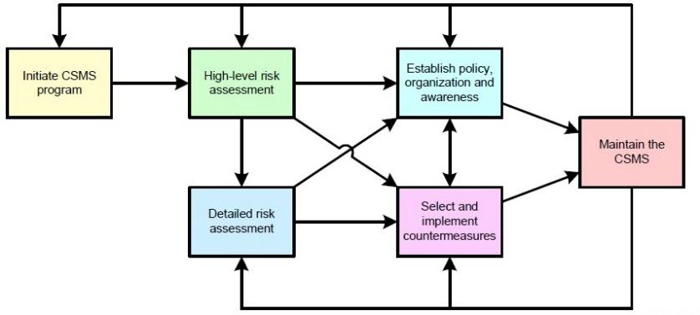

Slide 3
As these activities consist of many tasks requiring specific and new skills, Enexis invested in training internal staff on ISA/IEC-62443 knowledge and contracting external staff where necessary.
Depending on the size of the organization and the number of assets involved it can take either months or several years. Therefore, it is very important to invest effort and time in the initiation phase. Commitment of important stakeholders (e.g. formal and informal leaders) is important. Cyber security has proven to be a topic that is not tangible and well understood. Therefore, an interactive artist impression of the process of setting up the CSMS was developed.
it is very important to invest effort and time in the initiation phase
Enexis chose to have an initial scope where the highest OT security risks were included. Therefore, the entire Asset Management business unit and the central Scada / Control Centre, the central OT data centre, all HV/MV stations and all related processes within the internal Service Provider INFRA were included in the initial scope
During the high-level risk assessment, a methodology for identifying and assessing the priority of cyber security related risks needed to be defined. At DSO Enexis the choice was made to use the bowtie method [4]. A bowtie diagram visualizes the cyber security risk you are dealing with in one understandable picture. The diagram is shaped like a bowtie, creating a clear differentiation between the proactive and reactive side of risk management. The bowtie method is a qualitative risk analysis method that is used at Enexis for all kinds of risks related to electricity and gas grid management. It has proven to serve very well for analysing OT cyber security related risks
As Enexis is an organization with more than 100 years of history, formed after several mergers, many generations of different OT systems exist. Therefore, an extensive cyber security assessment lasting over 9 months was performed on multiple HV/MV substations. Contracted ethical hackers, cyber security specialists from ENCS and OT (cyber security) experts from Enexis jointly analysed the OT cyber security risks in detail to be able to perform an accurate detailed risk assessment and formulate adequate measures.

Slide 4
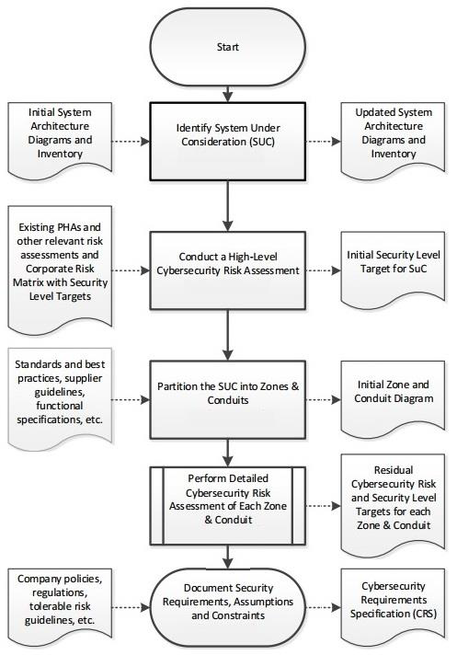
The outcome of the high-level risk assessment has served Enexis in choosing which risks to analyse in more detail first as it is a resource intensive task. So, the execution of the risk analysis has also had a risk based approach. The highest risks have been analysed in detail and treated with a higher priority. Below image shows the workflow defined by parts ISA/IEC-62443-3-2 and 3-3 of the standard. It offers a practical step-by-step approach and has given Enexis a formalized approach for assessing and treating OT cyber security related risks.

Slide 5
Establishing policy, organization and awareness
When Enexis started implementing ISA/IEC-62443-2-1 no mature OT security practice existed. As a result, most of the policies demanded by the standard for a professional treatment of OT cyber security risks needed to be implemented. Figure 6 shows all the elements of the CSMS and for all elements policies were written. For example for “Personnel security” a policy was written related to screening of internal and contracted personnel and for “Incident planning and response” on how to deal with OT security incidents.
Besides policies, effort was put into creating appropriate awareness. This was done through formal training at ISA, internal awareness campaigns using artist impressions, informal meetings, more formal presentations at management team meetings, Red Team / Blue Team trainings, etc.
Select and implement countermeasures
By following the process described in the ISA/IEC-62443 standards and tailoring it for Enexis, a large number of countermeasures were implemented effectively. Some of these measures are:
Defining & implementing policies for firmware patching and OT security incident planning and response
Implementation of an advanced Intrusion Detection System to detect anomalies in the OT network traffic
Training and awareness for all relevant stakeholders
Advanced firewalls between the OT and IT environment
Advanced IEC-60870-5 protocol proxies for enforced one-way 104 traffic in critical points of the architecture
Maintain the CSMS
Every month a meeting takes place to evaluate the progress and the performance of the CSMS. The OT Security Officers from Asset Management will define actions if necessary, based on the evaluation in collaboration with the OT Security Manager and Operational OT Security Officer from the internal service provider INFRA. Furthermore, formal internal audits are executed to verify if OT security adheres to established policies and procedures. Via ENCS and OT and IT Security Officers of Enexis that participate in meetings organized by the National Cyber Security Center of The Netherlands, new OT security trends are monitored as well as changes in the legal or regulatory framework. This enables Enexis to react on relevant developments and adapt the CSMS accordingly.
FilePath= Desktop/ICS_notes/CIRED 2019-117.pdf

Slide 6
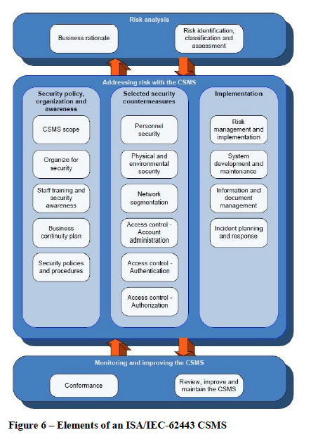

Slide 7
Paper-2:Designing and Integrating IEC 62443 Compliant Threat Analysis
The novel standard IEC 62443 prescribes security practices throughout the development lifecycle that improve the security of the resulting product. However, implementing and integrating concrete security practices into the existing development processes is challenging, as best practices for the automation domain are still missing. Hence, in this paper we present our implementation of a standard compliant threat analysis for the development process of the industrial control systems manufacturer Phoenix Contact. Phoenix Contact was successfully certified for its compliance with IEC 62443. We illustrate the requirements of the standard, the resulting threat analysis process, and its tight integration into the existing development process and its tools.
However, the standard is implementation-agnostic and describes what needs to be implemented, but not how. Therefore, organizations have to come up with concrete security practices that conform to the standard. However, as it is a novel standard, there are no established best practices for the industrial automation domain. Thus, companies struggle with implementing concrete security practices into their existing development processes such that it meets the requirements of the standard and that they can get certified for compliance with IEC 62443.

Slide 8
Phoenix Contact, headquartered in Blomberg, Ostwestfalen-Lippe, Germany, is a manufacturer of industrial automation, interconnection, and interface solutions. The company develops terminal blocks, relays, connectors, signal conditioners, power supplies, controllers & PLCs, I/O systems, Industrial Ethernet, controller system cabling, PCB terminal blocks & connectors, and surge suppression.[1] In addition, Phoenix Contact manufactures products for use with Modbus, DeviceNet, EtherNet/IP, CANopen, PROFIBUS and PROFINET networks.
Phoenix Contact is one of the companies that faced this challenge. The company is a manufacturer of industrial automation, interconnection, and interface solutions. Among other products, the company produces programmable logic controllers (PLC) that are a core component of industrial control systems within
the industrial automation domain. The company is now among the first ones that is certified with respect to the standard IEC 62443. In this paper, we focus on threat analysis as a security practice early in the development lifecycle. Using threat analysis as an example, we illustrate, how we designed IEC 62443 compliant security practices and how we implemented them into the existing development processes for PLCs at Phoenix Contact.

Slide 9
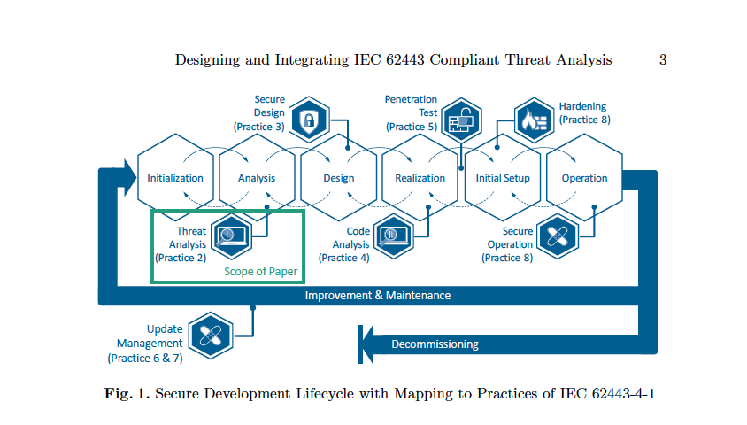

Slide 10
The very first security practice in the secure development lifecycle is threat analysis (corresponds to Practice 2 ). Threat analysis is used to identify the system's assets, its security objectives, threats to it, and associated risks. Using these results of the threat analysis a secure design can be created (corresponds to Practice 3 ), which specifically targets the identified threats with appropriate countermeasures on an architectural level. This ensures that the risk of the threats is reduced to an acceptable level and the product design is secure.
The next security practice is code analysis (Practice 4 ). The realization of secure design can introduce new vulnerabilities, e.g., due to aws in the code like buffer overflows. Thus, code analysis is applied to find and fix flaws possibly present in the code. Afterwards, security tests and penetration tests should be performed(Practice 5 ). Security tests validate that appropriate mitigations for each threat are in place as test cases are defined and executed for each identified threat. In contrast, the penetration test is used to exploratory test and ensure that there are no other possible ways to break into the developed product. When setting
up products in the field, the process demands hardening, as well as continued secure operation (Practice 8 ). This security practice is important, as many vulnerabilities are caused by faulty deployments or arise through misconfiguration or reconfiguration during operation. The update management (Practice 6 & 7 ) is needed, as the product is usually used over an extended period of time. In
this way, the process also covers the long-term security of the created product. Its purpose is to be able to quickly fix vulnerabilities after the product has been released in order to restore its security. As these updates need to be developed securely as well, they need to run through all the described security practices.

Slide 11
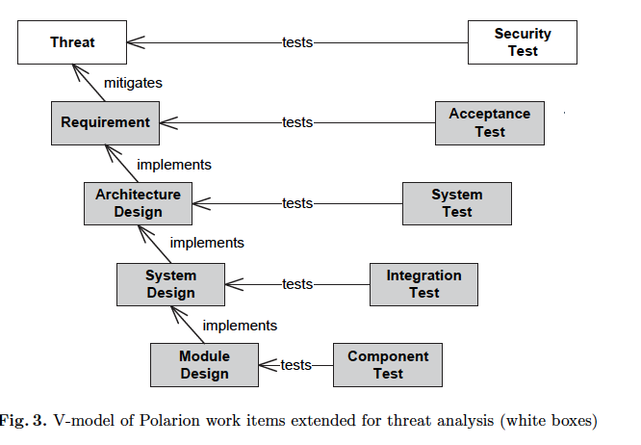
Initial model:
Their overall V-model process covers the whole interdisciplinary development, starting from the product idea it covers requirements, development, testing, and finally the continued support. Phoenix Contact uses the application lifecycle management (ALM) tool Polarion4.
It is used to specify work items for requirements, design specifications, development tasks, test cases, and defects (cf. Fig. 3). A crucial role of Polarion is ensuring the traceability throughout the whole process. Each aforementioned work item is traced to its ancestor work item. Therefore, it is well documented which specification, task, or test case impacts which requirement.

Slide 12
It was important that the designed threat analysis supports an iterative and repeated execution, so that it its well with the existing V-model and agile process. In order to implement the threat analysis, it was necessary to adapt
the process, but also the tools. The goal being that they are well integrated with Polarion, while fulfilling organizational and standard-driven requirements as listed in the following section.
Threat Analysis Requirements:
The process for threat analysis that was integrated into the existing Phoenix Contact development process, had to meet requirements prescribed by the standard IEC 62443 [3, 4] and requirements posed by the organization.
The IEC 62443 poses the following requirements [3]:
(1) A threat model with the system's architectural elements, assets, security
context, attack vectors, and trust boundaries shall be specified.
(2) Threats shall be identified, including the assessment of their unmitigated
and residual risk.
(3) Countermeasures shall be defined that contribute to the CRs and CR-REs.
(4) The traceability of work products, from threats to countermeasure requirements
and test cases shall be ensured.
In addition to the requirements prescribed by the standard, we also elicited
requirements stemming from existing processes, tools, and people:
(5) The threat analysis process shall integrate into the existing hybrid development
process and be applicable in the V-model and agile approach.
(6) The effort for threat analysis during product development shall be as low as
possible (reasonable and manageable).
(7) The threat analysis process shall be accepted by all stakeholders.
(8) Hence, the stakeholders shall be supported by tools that guide the analysis and automate tedious, recurring, and error-prone tasks.
(9) These tools shall integrate with the existing development tool-chain.

Slide 13
Describing steps 1-4:
The Steps 1 to 4 are executed by a team consisting of product managers, product owners, software architects, developers, and security experts. Typically, each step is executed in form of a workshop with approx five participants from the mentioned roles and moderated by a security expert. Step 5 represents the default development process and, hence, is executed by software architects and developers.
Step 1 In the first step, the system architecture and its security context is specified in a threat model. The system architecture is specified as a data flow diagram that contains the components that interact with the system's environment, their assets, their interaction path, and the used communication technologies. In addition, trust boundaries are specified to identify different zones of trust.
Together with the system architecture, the system's security context is defined. It specifies the assumptions about security measures in the environment of the system, e.g.,precautions taken by the customer.
The threat model is specified using the Microsoft Threat Modeling Tool(TMT) which is available free of charge. It supports threat analysis by providing a so-called threat model template that defines the usable types of model elements. For compliance with IEC 62443, we tailored the template to the industrial automation domain to account for the domain-specific taxonomy, technologies, and threats. By using TMT to document the information described above,the threat model contains all details required by IEC 62443

Slide 14
Step 2 In this step, threats to the system specified in Step 1 are identified using the STRIDE approach [9] and analyzed. For each identified threat, the risk of exploitation is assessed, if no countermeasures are taken (i.e., the unmitigated risk). Based on the specified threat model and the threat model template, TMT generates threat candidates for each STRIDE category. The team has to analyze
those threat candidates for applicability. In addition to the generated threat candidates, further threats have to be identified by creative thinking.
Our Bug Bar has five severity levels (from negligible to catastrophic). Separately for each STRIDE category, it defines what consequences map to what level (concerning just the PLC, not the system it may be used in). E.g., a tampering threat is considered
catastrophic if it gives the attacker full control of the PLC. This allows the team to easily read on the standardized severity for every STRIDE threat in the context of PLCs.

Slide 15
In the third step, countermeasures are defined that mitigate the threats identified in Step 2. The countermeasures are specified as requirement work items in Polarion. For traceability, each countermeasure requirement is linked to the threats it mitigates (cf. Fig. 3) and the IEC 62443 CRs and CR-REs that it contributes to (cf. Fig. 2). In addition, these requirements are linked to architecture design specifications and acceptance test cases as defined in the existing Phoenix Contact development process
Step 4 In this step, the risk of each threat is determined that remains after the defined countermeasures are in place (i.e., the residual risk). This risk is determined using the same assessment approach as for the unmitigated risk in Step 2, i.e., using the adapted bug bar and likelihood metrics and the custom risk calculation tool. If the residual risk is considered too high (not acceptable), additional countermeasures have to be defined by returning to Step 3. The result of Step 4 is a list of threats with their residual risk as required by IEC 62443 (cf. Req. 2 in Sec. 3.2).
After Step 4, the results are a list of threats with unmitigated and residual risk (specified as threat work items in Polarion) and a list of countermeasures mitigating those threats and contributing to the standard's CRs/CR-REs (specified as requirement work items in Polarion).
Step 5 Once all countermeasure requirements are specified and all residual risk is accepted, the countermeasures have to be designed and implemented in accordance with the existing development process.

Slide 16
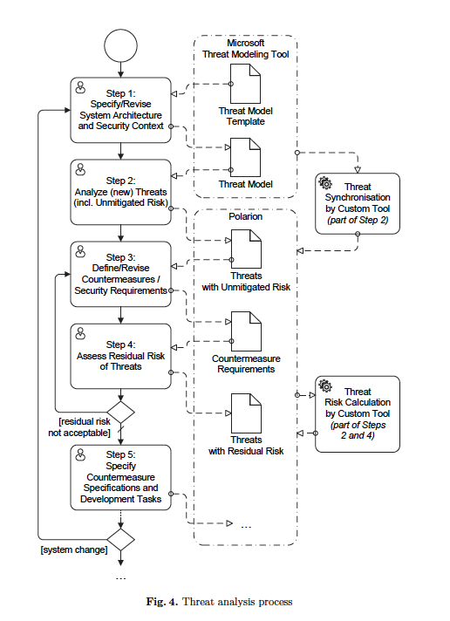

Slide 17
After Step 5, whenever the system is changed such that the threat model is no longer in sync with the development state (e.g., at start of a new sprint), the threat analysis process is repeated from Step 1. The threat model is updated to
reflect the system changes, newly introduced threats are analyzed, countermeasure requirements are revised/added, and the risks are updated.
Lessons Learned
During the design and integration of an IEC 62443 compliant threat analysis in the existing development process, we made several key findings which we present in the following. The findings can be categorized in findings concerning the process and its usage, as well as concerning the threat analysis itself.
File_name= Desktop/ICS_notes/paper_researchGate.pdf

Slide 18
Paper-3 Managing ICS Security with IEC 62443
In a companion whitepaper, “Effective ICS Cybersecurity Using the IEC 62443 Standard,” we looked at the structure and purpose of IEC 62443 and how Fortinet products can assist in implementing the security requirements stated within the Standard. In this paper, we examine how to use the Standard to strategically reduce your ICS cybersecurity risk.
Without using the Standard, any organization attempting to implement a set of common cybersecurity controls throughout the entire ICS will have varying degrees of success with each of those controls. Some controls may be extremely costly. Some organizations may discover that the technology does not support the control. Some controls will fail to align well with business operations. For those improvements driven by policy, the unachievable controls (such as systems in violation) will fall into several documented policy exceptions.

Slide 19
Meeting and maintaining the implementation of the Standard is the responsibility of everyone involved in the ICS cybersecurity risk to the organization. This group includes product suppliers or manufacturers (such as vendors) intended to be used in industrial control systems. All control systems rely heavily on many different technologies developed by many different product manufacturers, all of which rely on the integration of multiple systems to ensure reliable and safe operations
In addition to the traditional corporate risk managers, security managers and other IT roles, other critical roles needed for success will include some or all of the following: operations managers, plant managers, automation engineers, instrumentation engineers, process engineers, mechanical engineers, health safety and environment managers, ICS vendors, ICS OEMs and ICS systems integrators. The actual job titles, roles and responsibilities will vary by organization and sector.

Slide 20
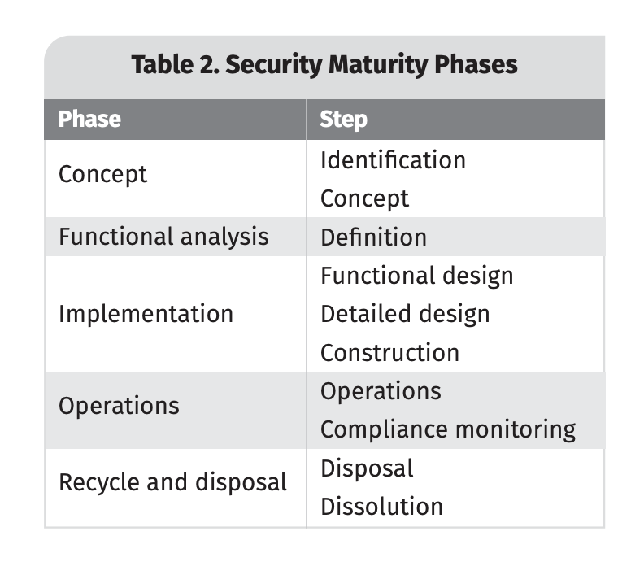
Each phase is covered in the IEC 62443 standards documents and should be thoroughly reviewed and implemented to meet the cybersecurity needs of the ICS

Slide 21
The Value of a Perimeter Control
Having a distinct perimeter between the control systems environment and the rest of the organization and external world provides a significant advantage and, for most, is the best starting point for addressing ICS risk and improving security posture. This perimeter defines clear business boundaries
With an established ICS perimeter, it is more difficult to refine and build upon a more refined security posture. A more refined risk assessment analysis process provides guidance into focused risk management of internal ICS operations

Slide 22
IEC 62443-3-2 is a guide that covers a process of assessing ICS risk that incorporates the risk factors and mitigations that are unique to an enterprise network. Consider the following when deciding where to begin and where to end.
• Although countermeasures may seem easier to implement at security level 1, changes in security zones at security level 4 typically result in more benefit to an organization.
• ICS operations typically contain multiple security zones, but this does not mean they operate in isolation of each other.
• Inter-zone operational dependencies, communications and information exchange (referred to as “conduits” in the Standard) will exist and will need to be analyzed for risk.
• Establishing the target security level needed to reduce risk establishes justification to implement.

Slide 23
An assessment may identify a list of recommended countermeasures. Each countermeasure will have an associated cost to implement and maintain. Many organizations would prefer to limit the number of security products and features introduced into their environment, and it’s important to realize that not all countermeasures must be in the form of security products and features. Because industrial control systems are engineered systems, they may be designed in alternative ways, with some more expensive to implement and operate than others. Seeking subtle opportunities, such as a change in communication path or segmenting a server application, can reduce the risk of a zone or conduit, thereby potentially lowering the security level or limiting the investment required to implement and maintain countermeasures. Additionally, re-architecting aspects of an environment will help build in a layered defense model and reduce the exposure of higher-risk zones. Simply having a countermeasure is not enough. The countermeasure must be managed appropriately over the course of its lifetime to ensure effectiveness
Three primary functions should be considered when selecting and implementing countermeasures that support security monitoring and response activities: visibility, control and actionable response.

Slide 24
Visibility. Visibility means having strategic sight of the underlying current state of the control systems build, the current state of operations and the interactions of a control system. Properties can include, but are not limited to:
• Cyber asset inventories
• Network traffic
• CPU processes
• Auditable login logs
• System event logs
• System documents/drawings
• Available security features
• Implemented security controls
• Contextual understanding of operations

Slide 25
Security controls. Security controls are safeguards or countermeasures strategically selected and implemented to:
• Strategically align to and implement sophistication of threats
• Reduce or minimize the risk, or effect, of a cyber-related event
• Support the reliability and safety of operations
• Provide detection and incident response capabilities Actionable response.
Actionable response is the capability to execute predefined processes, or playbooks, in response to ICS cybersecurity-related events and incidents. This capability includes, but is not limited to:
• Identifying and classifying the criticality of cyber-related events and incidents
• Notifying and communicating structure during an incident (including regulatory obligations)
• Performing an appropriate level of incident response aligned to the criticality of an incident
• Enabling or manipulating security controls, as appropriate, to isolate or contain the security zone from hostility during an incident response, managing the reliability and safety of an ICS during any cyber-related incident or activity

Slide 26
Because many industrial control systems were not designed with today’s knowledge of ICS security requirements, organizations that have them may face challenges to implement technologies to improve security
Fortinet provides coordinated coverage across a variety of security controls, including three of the most common challenges: boundary (zone and conduit) security, wireless security and remote access. Additionally, as a vendor that provides solutions for IT and ICS systems, Fortinet brings together capabilities to address advanced security requirements in demand for IIoT and cloud services such as micro-segmentation, application control and intrusion prevention/ detection systems

Slide 27
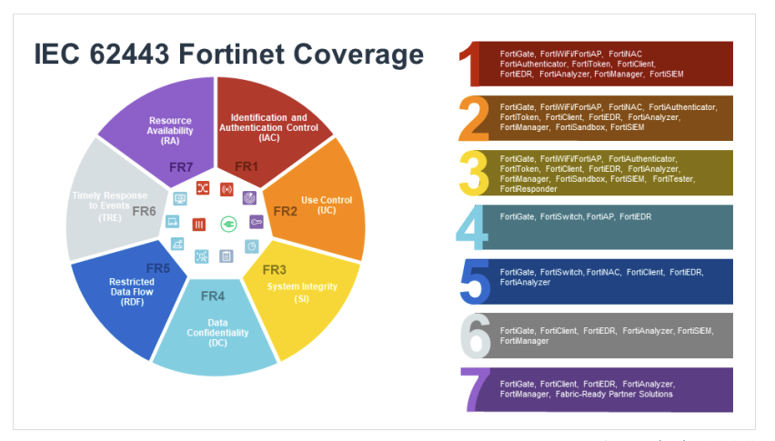

Slide 28
Conclusion
Through the relationships of the models provided in IEC 62443, implementation of this standard can help increase the security posture of an organization and ICS as a strategic, affordable and effective security program. Utilizing solutions such as the ones offered by Fortinet may improve the effectiveness of collaborating visibility, security controls and actionable response. Prevention, monitoring and response allow an organization to improve ICS security to align with the Standard and strengthen security operations.
Filename: Desktop/ICS_notes/SANS-Managing-ICS-Security-IEC-62443.pdf

Slide 29
Paper-4: DEVELOPMENT OF INDUSTRIAL CYBER SECURITY STANDARDS: IEC 62443 FOR SCADA AND INDUSTRIAL CONTROL SYSTEM SECURITY
This paper examines the development of standards for Industrial Control Systems (ICS) and Supervisory Control and Data Acquisition) SCADA security. Good practice and standards are reviewed, with a discussion on their future direction.
The paper provides an overview of these documents and the concepts they establish for process control systems and how these have been integrated into IEC 62443.

Slide 30
the National Institute of Standards and Technology (NIST) and the Department of Homeland Security (DHS), both of which collaborate with CPNI. Work to date by both US organisations incorporates good practice developed by CPNI. CPNI guidance also refers to documentation from both of these sources. The CPNI guidelines offer a generic approach to plant control and process information system security. The methodology provides a holistic framework, which incorporates all elements that should be considered when implementing a security programme. It is high level in nature and leaves the implementation decisions and detail to the organisation concerned.
To be continued ….
Filename: Desktop/ICS_notes/IEC 62443 FOR SCADA AND INDUSTRIAL CONTROL SYSTEM SECURITY

